Slide 1


Github for collaboration and version control
mae47@hawaii.edu
Install git: https://git-scm.com/downloads
The git for Windows install asks ALOT of questions, it works fine to go with the default for them all

Slide 2

Session objectives
To become familiar with Github and version control terminology
To become familiar with the Github web interface and available tools
To make a repository and commits
To use RStudio and Github together

Slide 3
Caveats!
Not an expert! And this is not exhaustive …
We will be focussing on Github rather than git

Slide 4
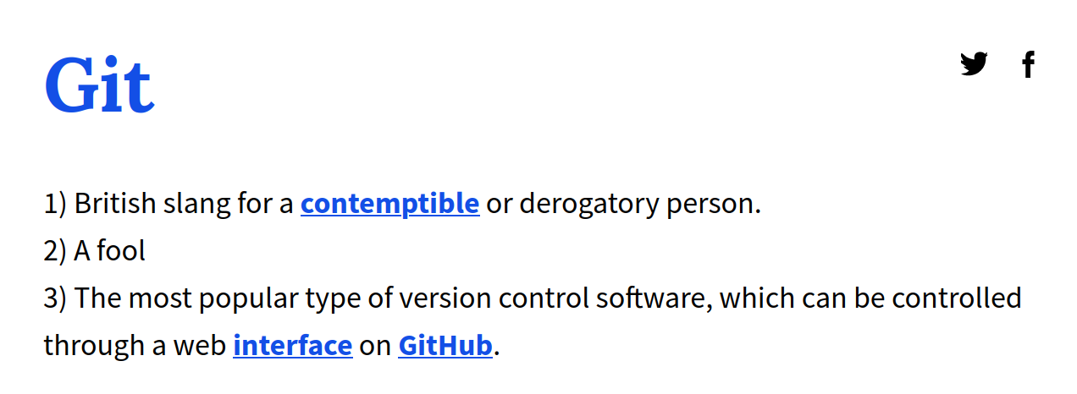


Slide 5
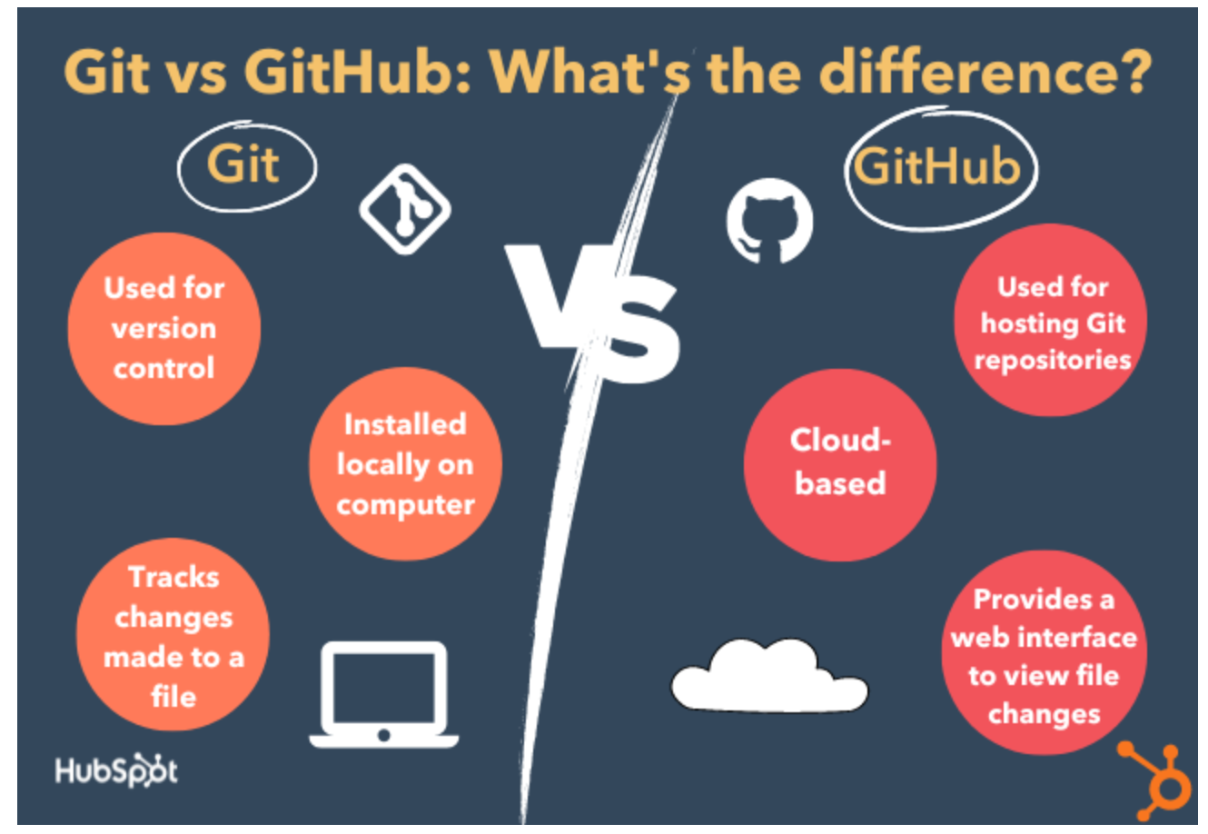


Slide 6
Why use github?
Project management
Version control
Collaboration

Slide 7
Demo! Overview of Github interface
Repositories
Overview
Stars
Projects - can make these within relevant repositories or link later
gists
Open up a repository
Code (README)
Issues (utilise # and @)
Project boards
Settings - add collaborators

Slide 8
Demo! Making a markdown file demo
Ones I use a lot
Other page links
Image notes and edit
Online example sheets eg https://www.markdownguide.org/basic-syntax/

Slide 9
Now have a go with it all!
Create own directory (go with defaults)
Play with issues and projects
Play with markdown files in code section. Make commits

Slide 10
Version control - follow with me
Observe history
View commit details - can leave comments
Browse repository at this point
Use arrow to get back to main
Can revert to commit # if using Github Desktop (not website)

Slide 11
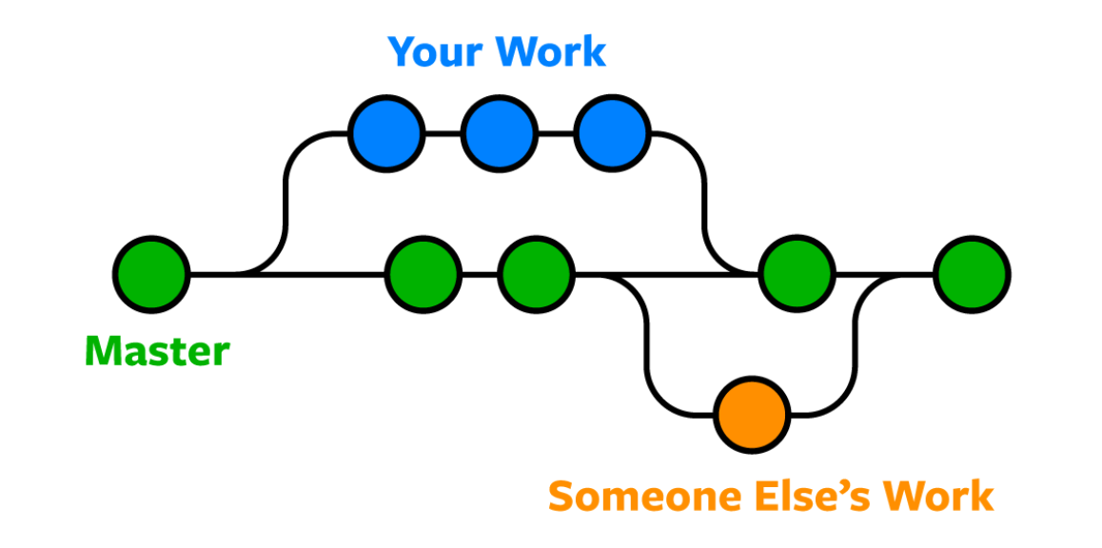
Collaboration

Slide 12
Demo! Collaboration
Click main arrow dropdown to create branch
Make your edits
Compare and pull request button at the top (or Contribute button)
Check details and create pull request
If branch has no conflicts - merge pull request
Confirm merge
Can delete editing branch or not
(can delete later via view all branches)

Slide 13
Demo! Collaboration
OR may need to resolve conflicts after creating the pull request
Delete the conflict markers and make the change you want in the final merge
Commit merge
Review merge (update default head branch or create new branch)
Now shows no conflicts, can merge pull request and confirm merge

Slide 14
NB Collaboration - both been working on main??
Both been changing the same parts of the same file at the same time?
When submit commit, get an error message that someone else has submitted commits since you started editing
Trying to commit wont work
Select “Create a new branch and start a pull request” and propose changes
As before, may be able to automatically merge, may not if there were conflicts - doesn’t matter, can still create pull request
Simply merge pull request or resolve conflicts as before
confirm/commit merge

Slide 15
Collaboration - not your repository?
Can still suggest edits! Just need to “Fork” first!
Then pull request

Slide 16
Linking RStudio to your repository
Work in RStudio and push changes to your github repository
Can work between the two!
Clones your repository to laptop
Adds *.Rproj file
To start!
Install git: https://git-scm.com/downloads
The git for Windows install asks ALOT of questions,
it works fine to go with the default for them all

Slide 17
The fussy part - Linking RStudio to your Github with a Personal Access Token
Open RStudio
install.packages(“usethis”)
library(usethis)
use_git_config(user.name = “Firstname Surname”, user.email = “yours@hawaii.edu”)
Link RStudio with Github using your “Personal Access Token” in Github
In RStudio: create_github_token()
This will take you to the Github website where you’ll give your token a name and
copy/save it (don’t lose it as it wont appear again!)
Store PAT in RStudio to connect to your Github account
install.packages(“gitcreds”)
library(gitcreds)
gitcreds_set()
Use your Github PAT as the requested password (also Github username if asked)

Slide 18
Linking RStudio to an actual repository
Easiest way - to have created Github repository first
In RStudio:
File > New Project
Version Control
Git
Enter your own repository’s URL
(I recommend to save the repository in a folder called github_repositories)
https://rfortherestofus.com/2021/02/how-to-use-git-github-with-r/

Slide 19
Using RStudio and Github
See Git tab
Order: commit, pull, push
https://rfortherestofus.com/2021/02/how-to-use-git-github-with-r/
NB If add random file to your locally saved github repository, this will also come up in RStudio for a commit!
Will then be reflected in your repo on Github web

Slide 20

Github for collaboration and version control
mae47@hawaii.edu

